Slide 1
Monday
Abel Sanchez

Slide 2
Create Teams – 10 mins
First activity of day – don’t explain
Number 1-to-5
1s together
2s together
3s together
…
Opportunity to talk about patterns later on

Slide 3
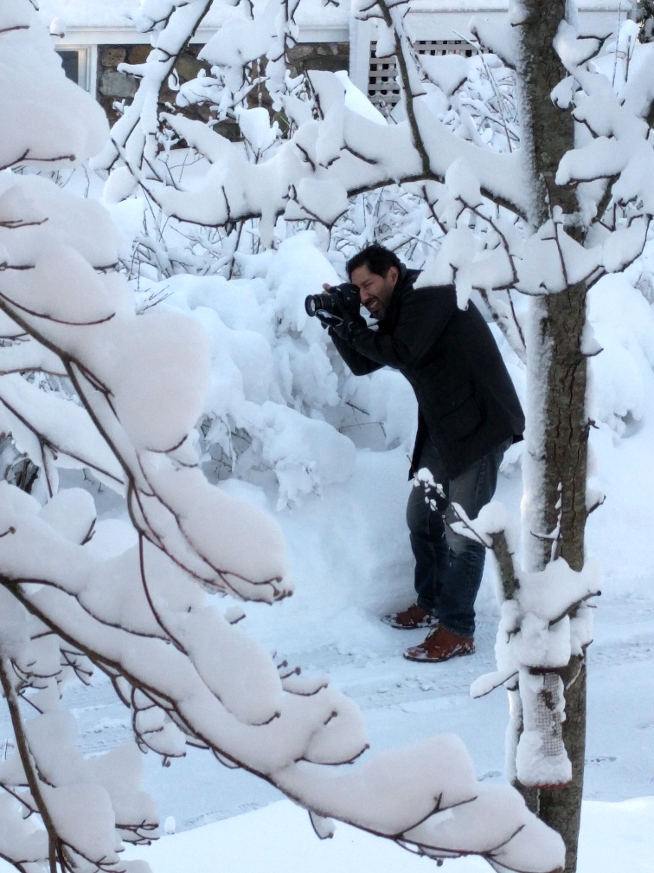
Instructor: Introduce yourself – 5 mins
Make it fun!
Who are you?
Where are you from?
What do you do for fun
Let them see you as a scientist
Let them see you as a person

Slide 4
Students: Introduce Yourself – 15 mins
Name
Why are you taking the class
DO NOT ASK where are you from (home address)?
City is okay
Hobbies
Instruments
Sports
Most common hobby was dance in 2017

Slide 5
Ice breaker - Draw a scientist – 15 mins
Hand-out Index cards
Collect
Group by patterns
Tape to wall

Slide 6
TA Task - Take photos of each index card
Upload to
TBD

Slide 7
Introduction – Beautiful Patterns – 15 mins
What were the patterns in scientist drawings?
What is a pattern?
Everyday patterns
User patterns derived from of students hobbies
Restaurant as a computer analogy
Emphasis: every academic field is a set of patterns
(Practicing professionals: apply domain patterns)

Slide 8

Maximize Happiness – 30 mins

Slide 9


Slide 10
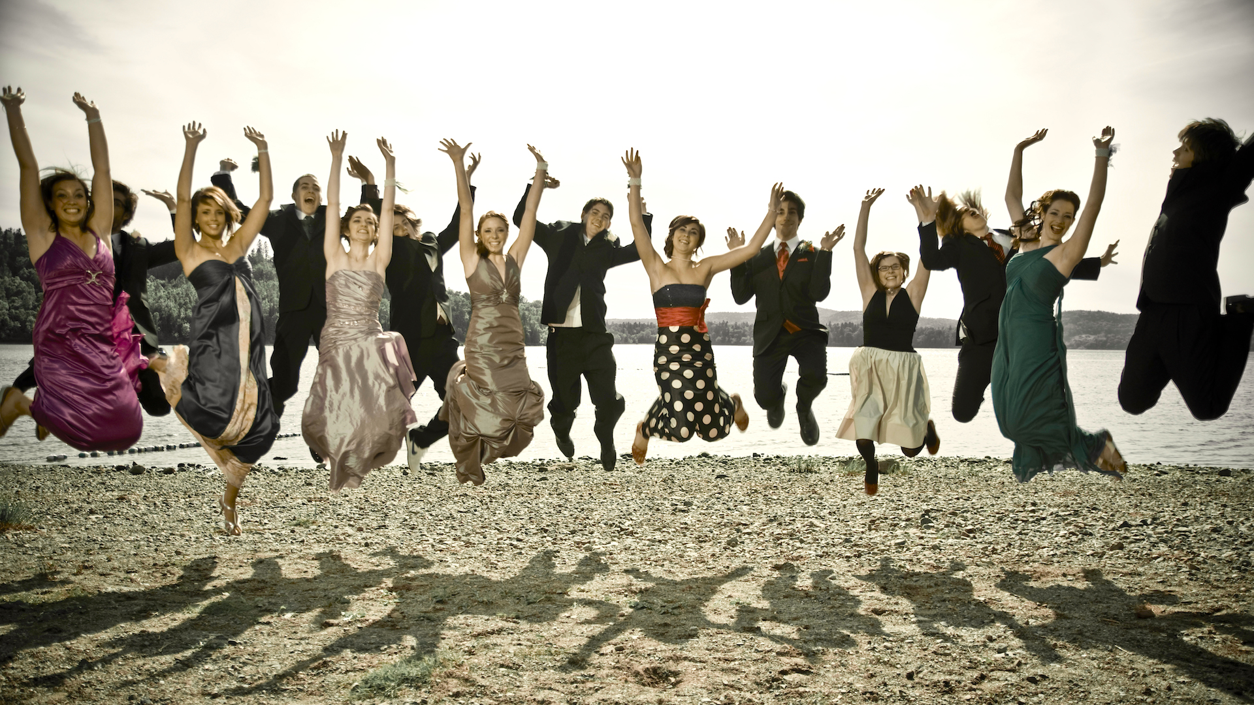

Slide 11
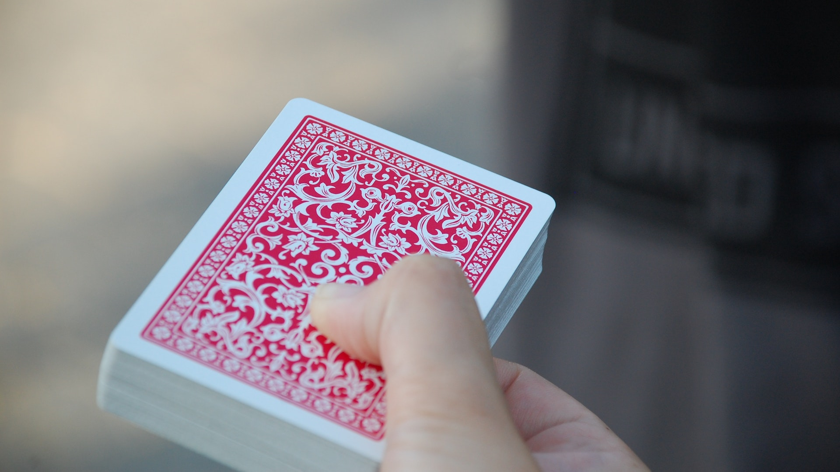

Slide 12
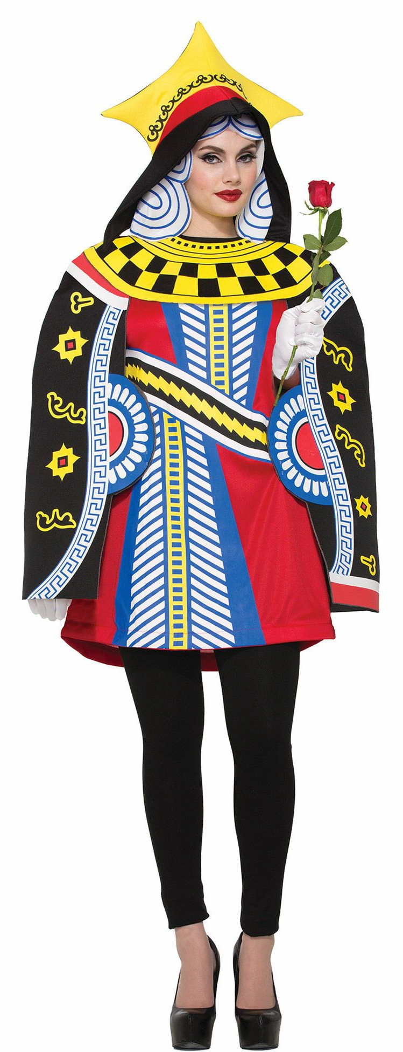
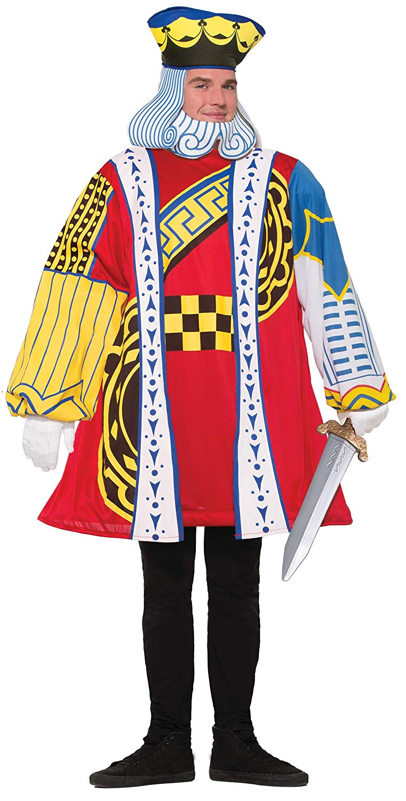
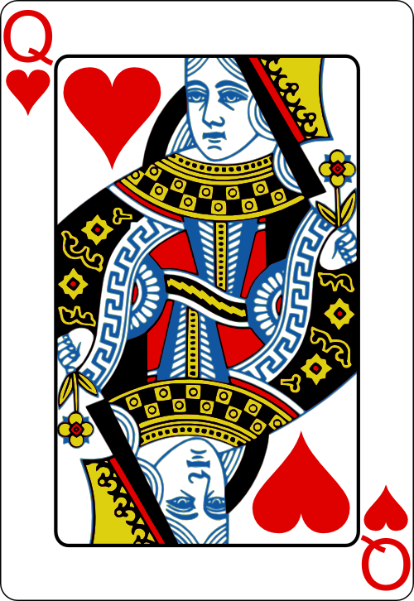
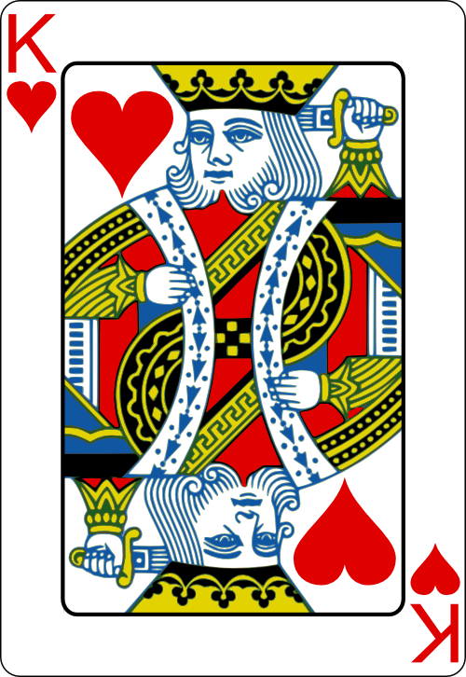

Slide 13
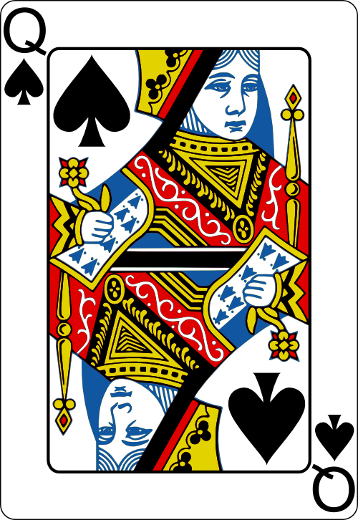
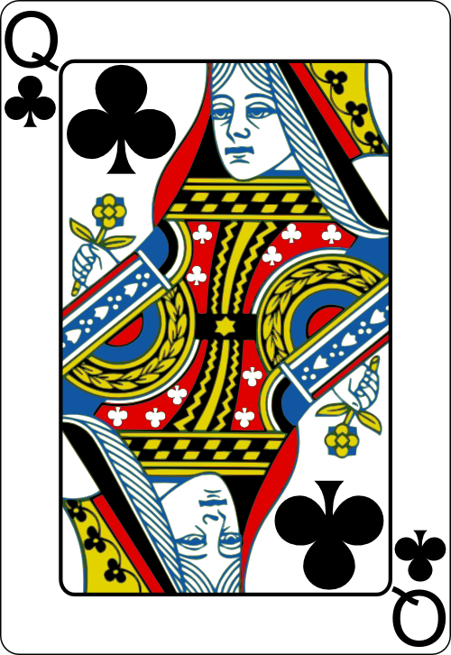
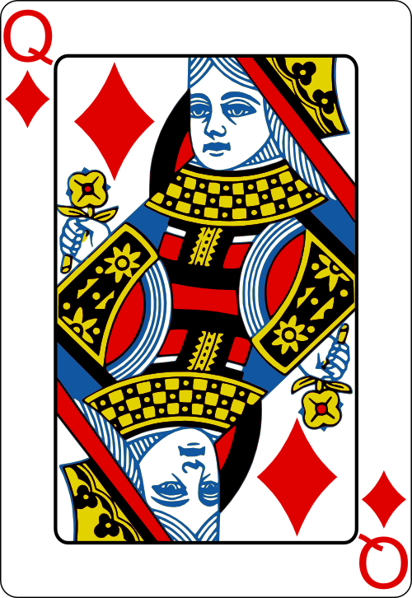

Slide 14
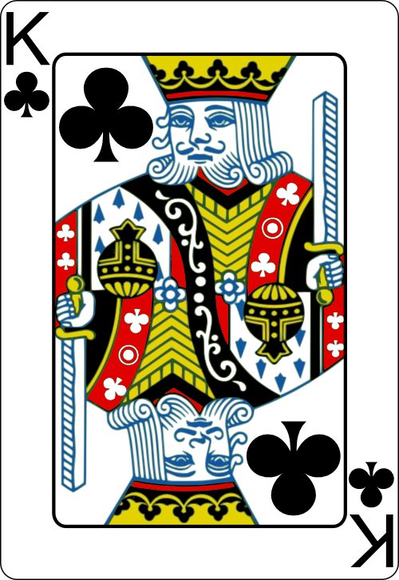
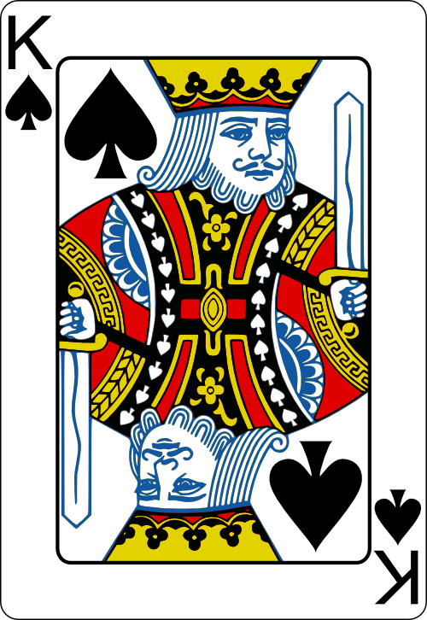
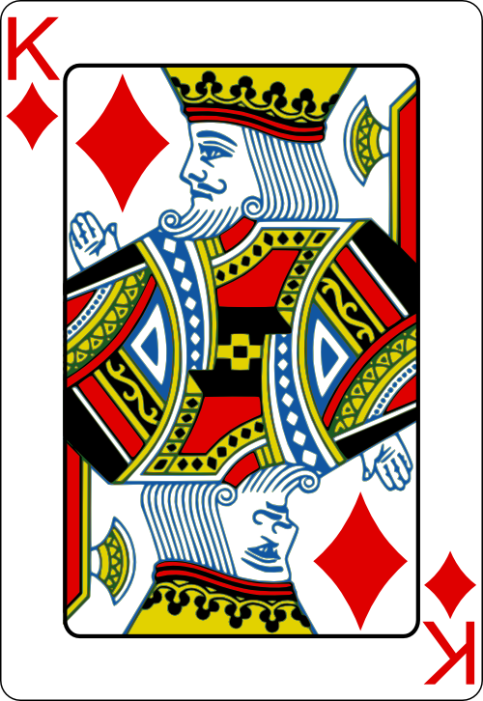

Slide 15
Maximize Happiness – 30 mins

Slide 16
Maximizing the happiness of a dating group
Explain the problem connecting to real life
The classic problem
You might like him/her, he/she may not like you
Levels of like
A fun discussion to have

Slide 17
Distribute materials
Provide students with cards
Provide students with card configuration
Ask them to maximize happiness
Scoring system
1st choice: 4 pts
2nd choice: 3 pts
3rd choice: 2 pts
4th choice: 1 pts

Slide 18
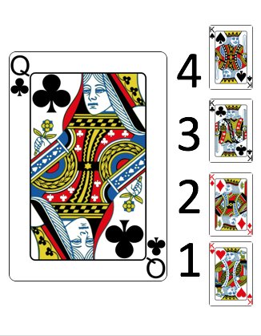
Sample Setup Image – Show one by one

Slide 19
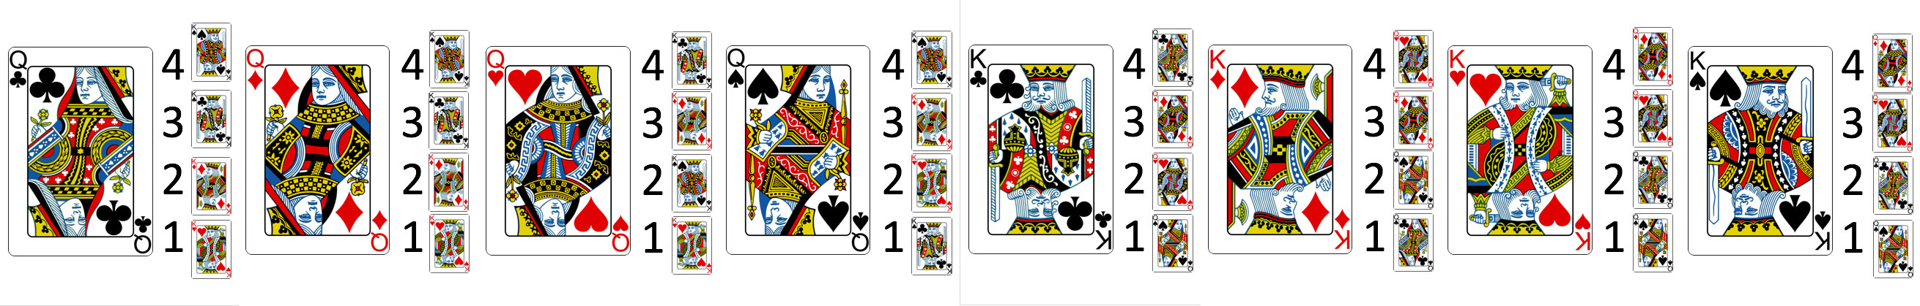
The complete list – PPT deck in git repo

Slide 20
Students compete for highest score

Slide 21
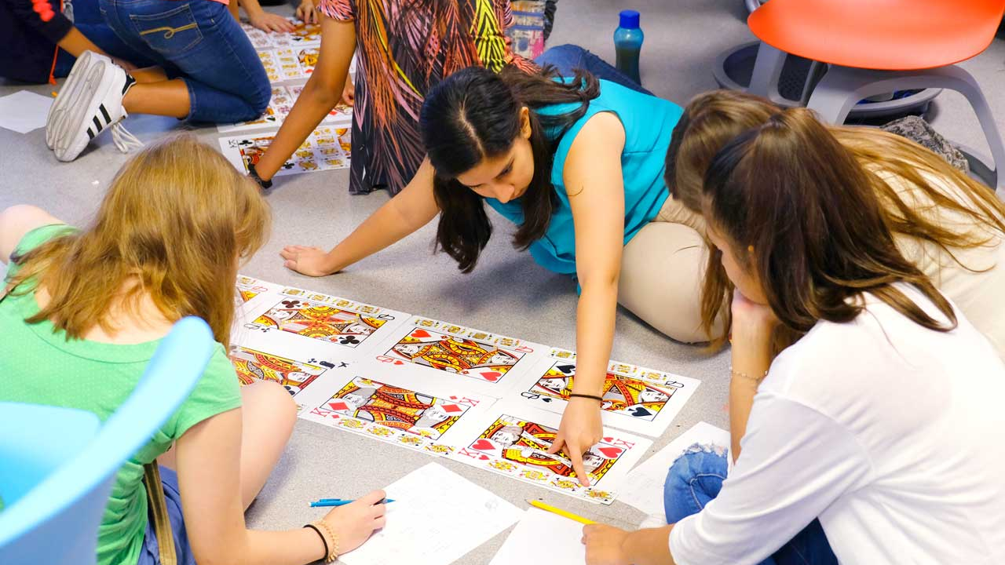
Student work – 30 mins

Slide 22
Gale-Shapley – phase 1 – 15 mins

Slide 23
With Algorithm – Round 1
Queens select their top 4 choices
Queens make proposals to their top choice (first paring)
King consider offers
King selects top offer (rejects others)
Rejected queens top choice is removed

Slide 24
With Algorithm – Round 2
Queens select their next top choice
King consider offers
King selects top offer (rejects others)
Rejected queens top choice is removed

Slide 25
Gale-Shapley – phase 2 – 1 hour

Slide 26
Apply Gale-Shapley to something of their own choosing
Explain problem
Support application
Every team presents

Slide 27
AFTERNOON

Slide 28

What is a computer?

Slide 29

What is it really?

Slide 30
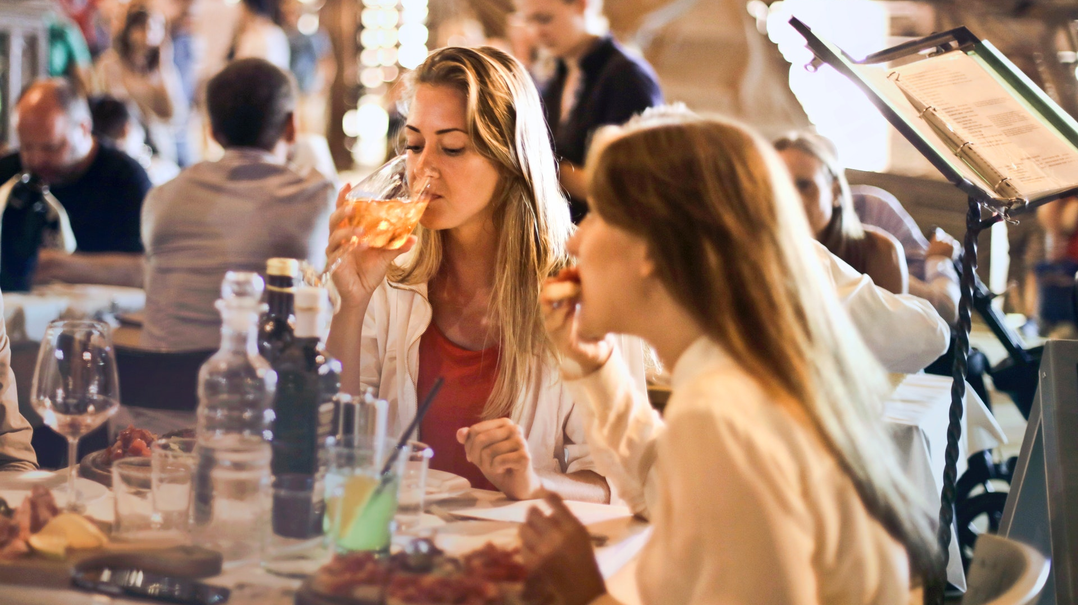
Users
I/O

Slide 31
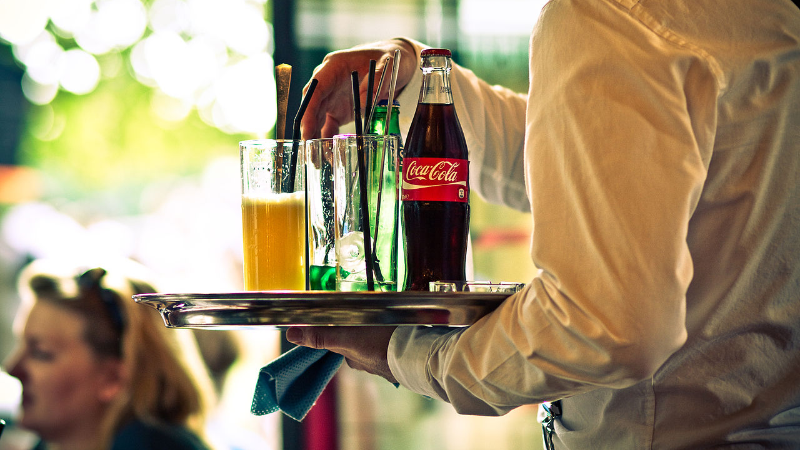
Messages

Slide 32
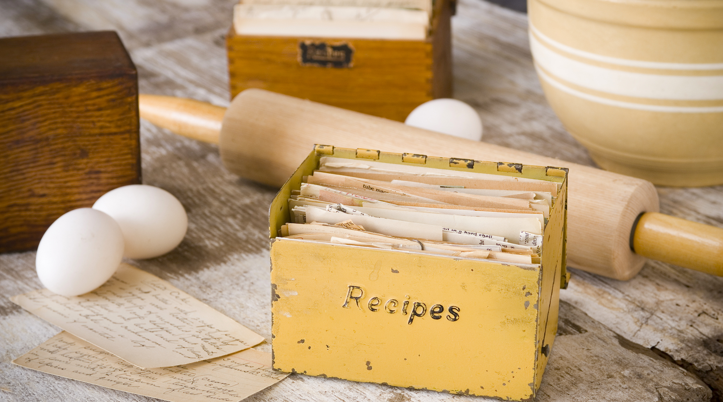
Storage
Storage
Storage
RAM

Slide 33
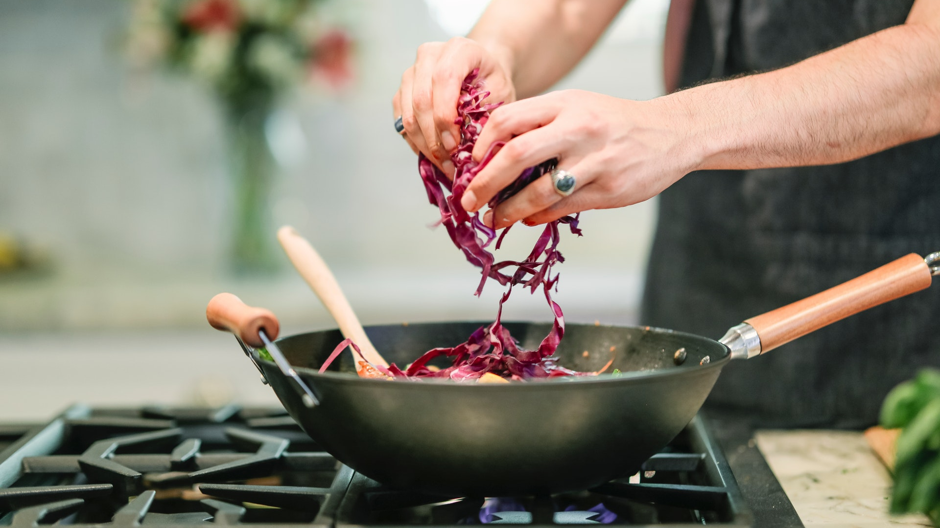
Chef - CPU

Slide 34


Slide 35
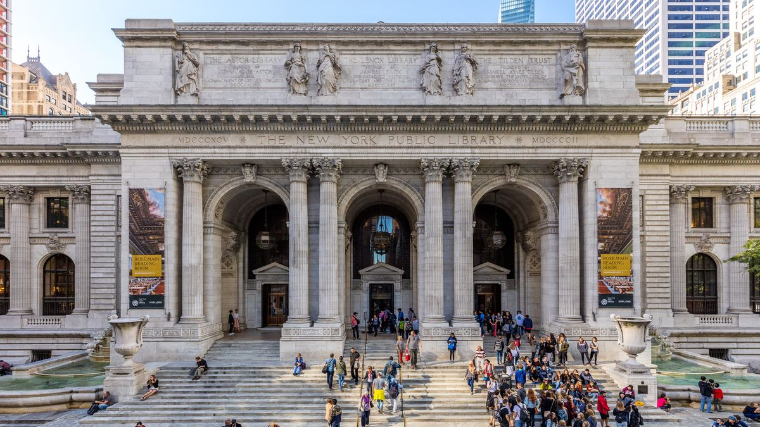

Slide 36
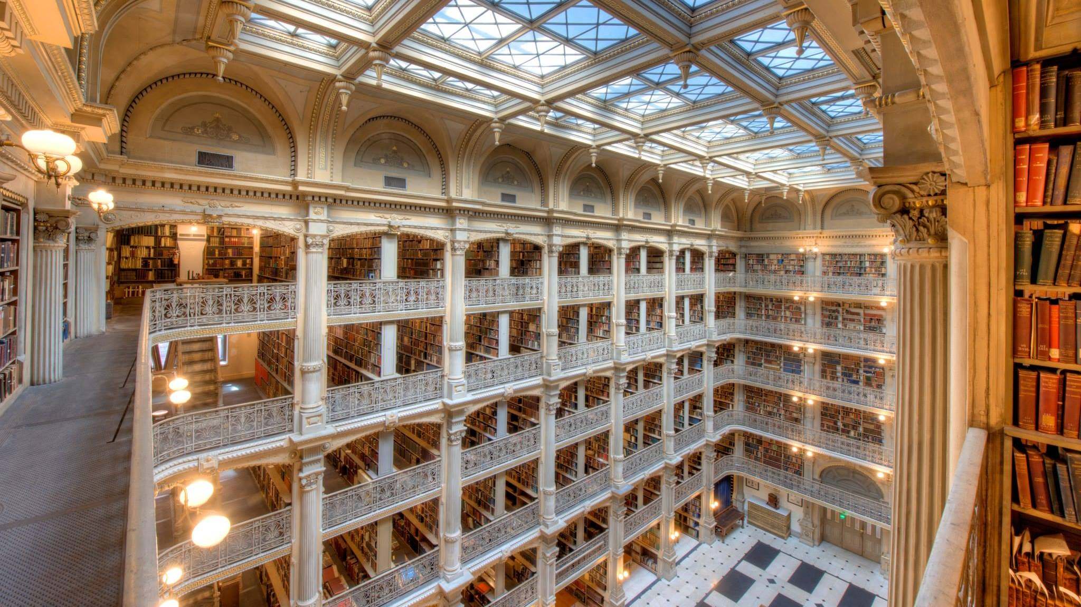

Slide 37


Slide 38
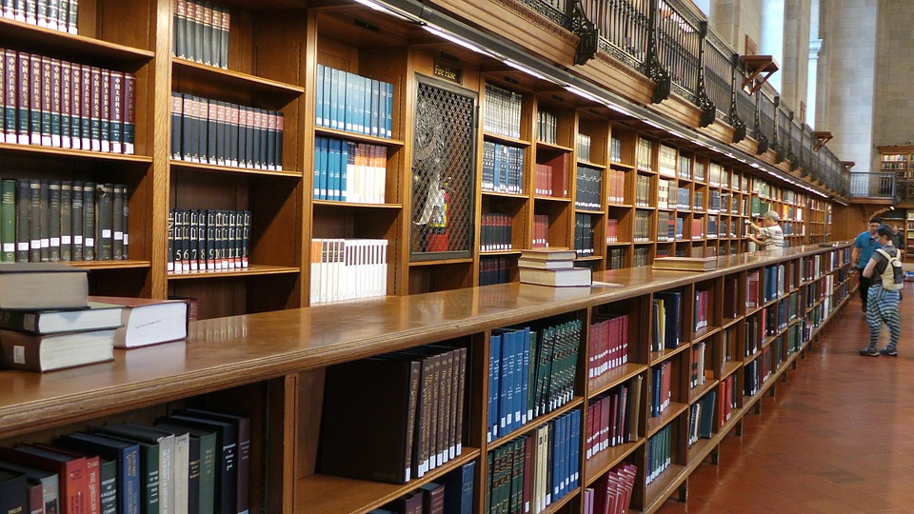

Slide 39
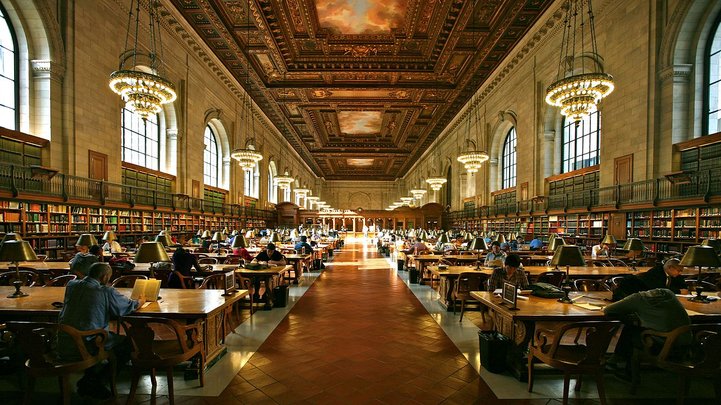

Slide 40
High level description of a computer
The restaurant analogy
Explain that we will write instructions
The computer will interpret them

Slide 41
Topics covered – Code for day is declarative
HTML
CSS
Screen coordinate system
Z-Index
DIV properties

Slide 42
Active learning
Declarative programming
Say ”Hello World!”

Slide 43


Slide 44


<div style="
z-index:5;
position:absolute;
left:100px;
top:200px;
width:100px;
height:100px;
border-radius:50%;
background:black">
</div>
<div style="
z-index:5;
position:absolute;
left:100px;
top:200px;
width:100px;
height:100px;
border-radius:50%;
border: 3px solid">
</div>

Slide 45
Active learning
Create a couple of shapes

Slide 46
top: 200
left: 100
height: 100
width: 100
background: black

Slide 47
y
z-index
left: 100
z
x
top: 200

Slide 48
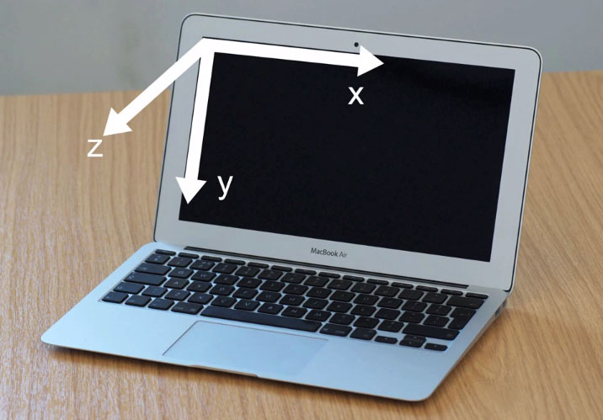
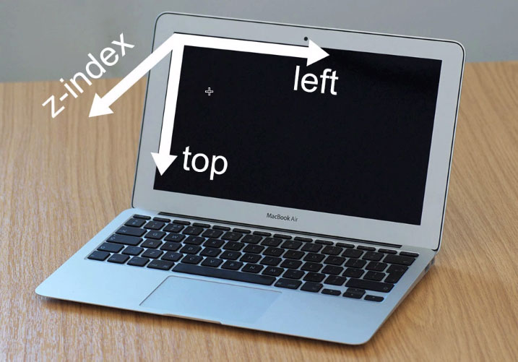
Coordinates

Slide 49


Slide 50
For more colors see:
http://goo.gl/uQVY8f
<div style="
z-index:5;
position:absolute;
left:100px;
top:200px;
width:100px;
height:100px;
border-radius:50%;
background:black">
</div>

Slide 51
Active learning
Create shape

Slide 52


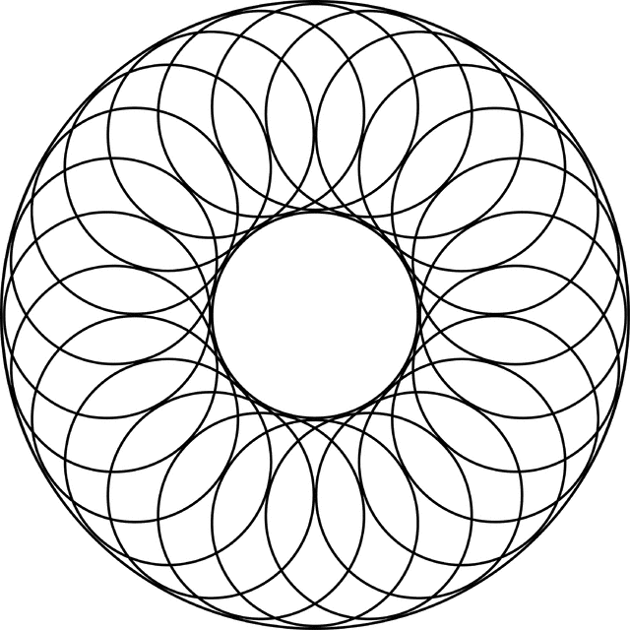
https://css-tricks.com/examples/ShapesOfCSS/

Slide 53


Slide 54
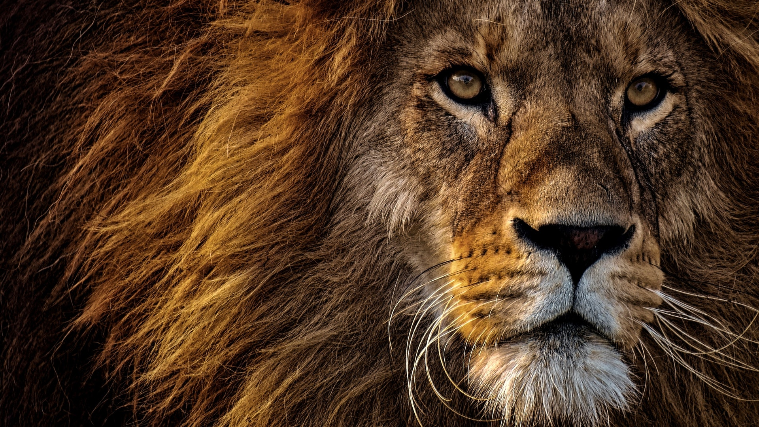

Slide 55
PROJECT

